Slide 1
Overview of the DARS Funding Allocation Process
January 2019

Slide 2
Timeline
Jan./Feb.
Notice of Grant Award (NGA)
Apr./May
Funding Formula & Area Plan Prep
June
Allocations and Area Plan Documents to AAAs
July
New State Fiscal Year
AAAs submit Area Plan
Sept./Oct.
Sept. - AP Finalized
Oct.- New FFY, Obligations/Contracts
Notes:
The funding allocation process begins with the Notice of Grant Award (NGA) and moves to the calculation of the funding formula and the resulting estimated allocations for the next FFY. This enables the AAAs to work in their localities to complete and submit the Area Plan. Finally, the process culminates with obligations/contracts being finalized in September and October.

Slide 3
Notice of Grant Award
Notes:
This is a Notice of Grant Award. Grant awards are the drawdown mechanism for DARS to receive funding from Administration for Community Living (ACL) for services provided by AAAs. Typically, DARS may receive a few small awards near the beginning of the FFY year with the bulk of the awards being received in Jan/Feb. This award represents the final Title III Notice of Award for FFY 2018. For FFY 2018, the majority of the award was not received until May, nine months into the FFY. As you can see, the final NGA was not received until September 2018 (Not typical).

Slide 4
Notice of Grant Award
Notes:
This award represents the final Title VII Notice of Award for FFY 2018.

Slide 5
Advanced Payment
The Commonwealth of Virginia is an advanced funding state. AAAs receive their allocations in advance. Allocations are estimated based upon level funding from the previous Federal Fiscal Year (FFY).
This means that in a typical year, DARS sends out estimated allocations in June so that AAAs can plan their budgets through their Area Plan process during the summer in time for the FFY beginning October 1. Typically, DARS receives the federal award through the Administration for Community Living (ACL) sometime in January or February.

Slide 6
Advanced Payment
For example: DARS received the Notice of Grant Award (NGA) a few weeks ago for FFY ‘19 (current year). DARS will use this amount to calculate the FFY’20 allocations that we send to the AAAs by early June 2019. This is an estimate based upon level funding.
The FFY ‘20 NGA may be more or less and may not arrive until the winter of 2020. The NGA gives DARS the authority to draw down federal funds. In most instances DARS partially covers the funding for a number of months before the final award is made.
Notes:
DARS recently received FFY’19 NGAs for Title III and Title VII for the full award amounts. Unlike last year, this falls into the normal time of year when we expect to receive NGAs.

Slide 7
Administrative Funds
Administrative funds (5%) are used for the operations of the State Unit on Aging (SUA) in accordance with the Older Americans Act Section 305(a)(1)(E). Administrative costs are calculated on the total Title III award and deducted prior to the allocation calculations. Costs for AAA IT user seats (PeerPlace) are also reserved in advance and taken out of the DARS administrative funds.

Slide 8
Administrative Fee Calculation
FFY XX Final Title III Award $31,000,000
Percentage for State Admin 5%
Total Admin Fee $1,550,000
Admin Fees are split between Title III B and Title III E
Title III E Admin Fee $4,000,000 (III E Award) x 5% = $200,000
Title III B Admin Fee $1,550,000 (Total Fee) – $200,000 (III E Fee) = $1,350,000
Notes:
This Administrative Fee calculation example shows that the total Title III award is $31 million. If we multiply that by 5%, which is the Percentage for State Admin, we get a total admin fee of $1,550,000. Admin fees are split between Title III B and Title III E. To calculate the split, we determine the admin fee for Title III E. In this example we are using $4 million as the total Title III E award amount which is multiplied by 5% for a total Title III E Admin fee of $200,000. The Title III E fee is then subtracted from the Total Admin fee to get Title III B’s admin fee in the amount of $1,350,000.

Slide 9
Reserve Funds
Reserve funding is an amount that is held back prior to the allocation formula calculations to ensure that we do not over obligate in advance of the actual appropriation. Reserve funding offsets time lags between advanced allocations and actual awards and provides a reserve during continuing resolutions and other delays. Unlike administrative funds,
DARS does not use reserve funding for DARS operations. The full amount is always allocated to AAAs before the end of the FFY. Because this amount is held back for a period every year, it is a rolling amount similar to carry over.

Slide 10
Reserve Funds
As noted, DARS operates several months into the Federal Fiscal Year (FFY) before receiving award notices. Funding to AAAs is advanced even though DARS has not received the full Notice of Grant Award (NGA) during this period. The actual award amount may be higher or lower than the original estimate at the time funds were allocated.
This funding methodology is designed to provide a reserve to prevent over-obligations and to soften the impact of delays. A reconciliation is performed to ensure that DARS fully obligates the award to AAAs by the end of each FFY.

Slide 11
Funding Formula
The Older Americans Act of 1965, as amended, Section 305,(a),(2),(C) requires the state agency to:
In consultation with area agencies, in accordance with guidelines issued by the Assistant Secretary, and using the best available data, develop and publish for review and comment a formula for distribution within the State of funds received under this title that takes into account –
The geographical distribution of older individuals in the State; and
The distribution among planning and service areas of older individuals with greatest economic need and older individuals with greatest social need, with particular attention to low income minority older individuals including low-income minority older individuals, older individuals with limited English proficiency, and older individuals residing in rural areas.
Notes:
The funding formula starts with the Older Americans Act and requires the state agency to consult with Area Agencies on Aging in accordance with the following guidelines: Read I and II.

Slide 12
Funding Formula
Virginia, working with the Area Agencies on Aging, updated its Intrastate Funding Formula beginning with Federal Fiscal Year's 2013 distribution. The funding formula includes a base of fifty percent of the Federal Fiscal Year's 2012 allocation.
All funds awarded above the base will be distributed using the existing established formula with data from the most recent 60 plus American Community Survey (ACS) special compilation produced by the US Bureau of Census. In no case will an Area Agency on Aging receive less than it did in Federal Fiscal Year 2006.

Slide 13
Funding Formula
Title III and VII
[For Subtitles III-B, Supportive Services; III-C, Nutrition; III-D, Disease Prevention and Health Promotion; III-E, National Family Caregiver Support; and VII-Chapter 3, Prevention of Elder Abuse, Neglect, and Exploitation]
DARS, in consultation with Virginia’s AAAs, has developed an intrastate funding formula for Older Americans Act funds. The Commonwealth’s Title III funding formula remains unchanged from the previous State Plan. The formula factors and their weights are as follows:
Population 60+ in Poverty 50%
Population 60+ 30%
Population 60+ in Rural Jurisdictions 10%
Population 60+ Minority in Poverty 10%
Notes:
An intrastate funding formula has been developed with the following formula factors and their weights. (State the Percentages)

Slide 14
Funding Formula
Title III
30% Population => age 60
+
10% Population => age 60 in rural area
+
50% Population => age 60 in poverty
+
10% Population => age 60, minority in poverty
100% Total Funds
Title III-D Preventive Health is further adjusted for medically underserved areas.
Ombudsman and CCEVP – Uses a separate allocation.
Notes:
The calculations are added together to create the funding formula for each PSA.
A later slide will illustrate the detail calculations used to determine each of the above groups’ respective portion of the funding formula.

Slide 15
Funding Formula
Description of Factors
Population 60+ in Poverty: This factor is an application of the definition of greatest economic need as required by the Older Americans Act. The financial condition of the older person is a major determinant of his or her ability to meet basic life needs such as food, shelter, mobility, and healthcare. The U.S. Bureau of the Census prepares this information upon request to perform a special tabulation for the Administration on Aging.
Population 60+: This factor is the basis for the distribution of funds by jurisdiction (county and city) of older Virginians. It reflects the proportion of persons age 60 and older throughout the Commonwealth by jurisdiction as provided by the U.S. Bureau of the Census.
Population 60+ Minority in Poverty: This factor addresses the special needs of older racial and ethnic minorities in Virginia as well as the economic needs of this group. The U.S. Bureau of the Census prepares this information upon request to perform a special tabulation for the Administration on Aging.
Notes:
The Description of Factors:
Pop 60 + in Poverty: identifies the population of greatest economic need as required by the Older Americans Act.
Pop 60 +: Reflects the proportion of persons age 60 and older
Pop 60 + Minority in Poverty: addresses the special needs of older racial and ethnic minorities in Virginia as well as the economic needs of this group.

Slide 16
Funding Formula
Description of Factors
Population 60+ in Rural Jurisdictions: This factor addresses the geographical isolation faced by older Virginians who live in the rural areas. DARS defines "rural" as any jurisdiction (city or county) which is not within a Metropolitan Statistical Area (MSA) or any jurisdiction which is within an MSA but which has a population density of 50 persons or less per square mile. An MSA is calculated by the U.S. Bureau of the Census and is updated in the formula when the census population data is updated. Square mileage by jurisdiction is obtained from the most recent Report of the Secretary of the Commonwealth and is updated in the formula when the census population data is updated.
Medically Underserved Area: This factor, applies only to Title III-D, Disease Prevention and Health Promotion Services. Section 362 of the Older Americans Act of 1965, as amended, requires the state to give priority to areas that are medically underserved.
Notes:
Pop 60 + in Rural Jurisdictions: addresses the geographical isolation faced by older Virginians who live in the rural areas. DARS defines “rural” as any jurisdiction (city or county) which is not within a Metropolitan Statistical Area (MSA) or any jurisdiction which is within an MSA but which has a population density of 50 persons or less per square mile.
Medically Underserved Area: This factor, applies only to Title III-D, Disease Prevention and Health Promotion Services and requires the state to give priority to areas that are medically underserved.

Slide 17
Funding Formula
Publications Used in Determining Funding Formulas
The most recent ACS Special Tabulation on Aging report is obtained and used to document Virginia’s demographic information for the applicable period.
https://agid.acl.gov/DataFiles/ACS2015/?stateabbr=VA
The most recent Office of Management and Budget’s (OMB) Metropolitan bulletin - establishes revised delineations for the Nation's Metropolitan Statistical Areas, Micropolitan Statistical Areas, and Combined Statistical Areas.
https://www.census.gov/programs-surveys/metro-micro/about/omb-bulletins.html
The square miles are obtained from the most recent U.S. Census.
https://www.indexmundi.com/facts/united-states/quick-facts/virginia/land-area#table

Slide 18
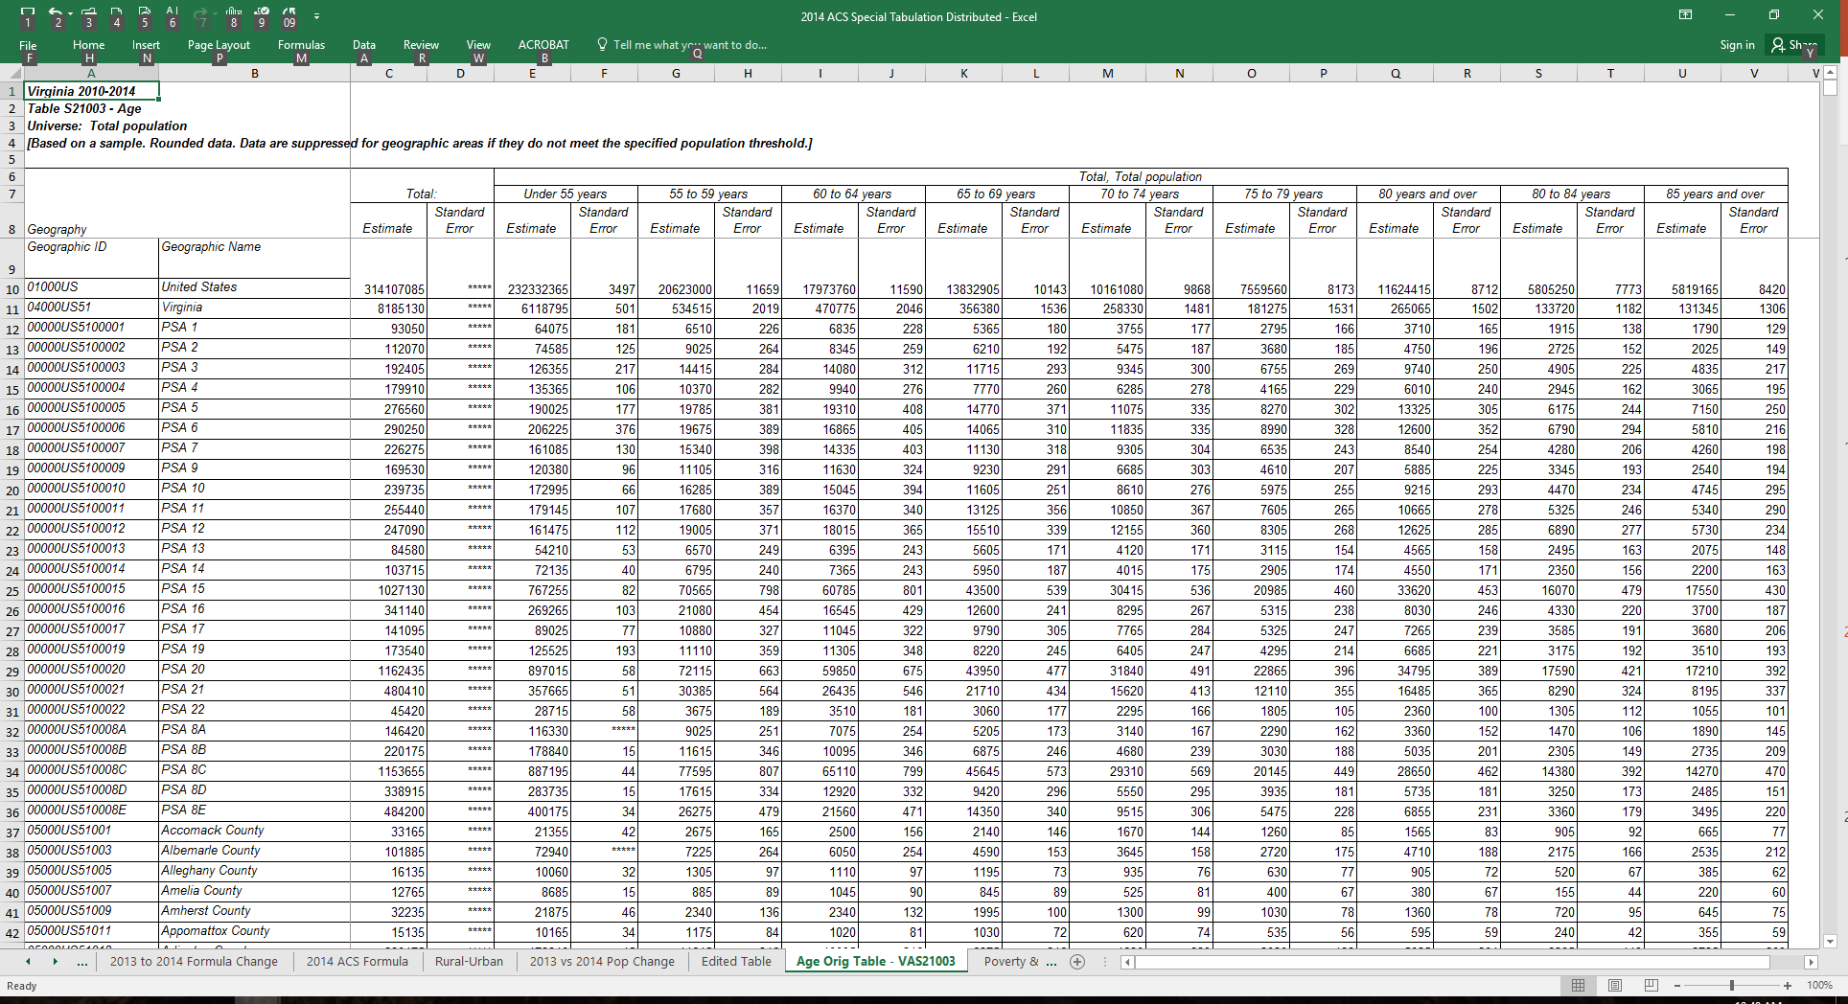
Funding Formula
Notes:
This is the ACS special tabulation for age population data that is used in calculating the funding formula.

Slide 19
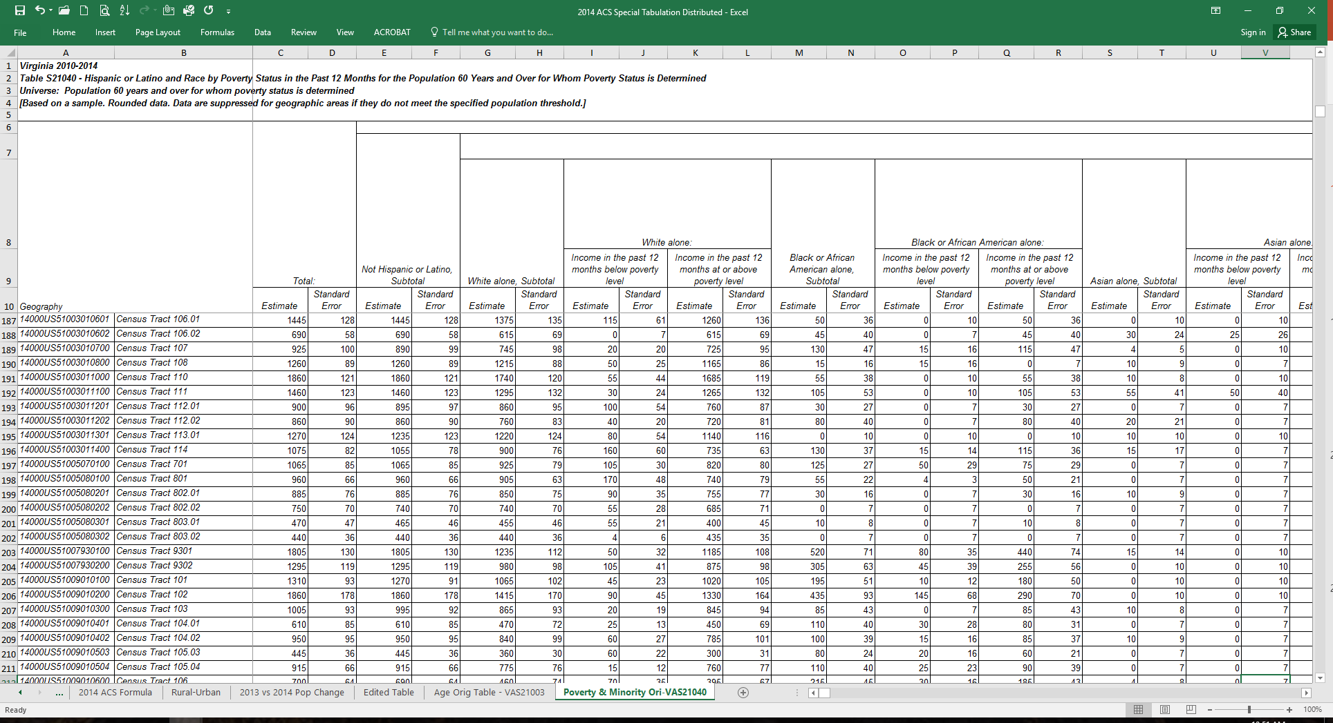
Funding Formula
Notes:
This is the ACS special tabulation for race and poverty status data for persons of 60 years of age and older.

Slide 20
MSA Details From OMB 18-04 Dated 9/14/18
13980 Blacksburg-Christiansburg, VA Metropolitan Statistical Area
Principal Cities: Blacksburg, Christiansburg
Giles County, Montgomery County, Pulaski County, Radford city
16820 Charlottesville, VA Metropolitan Statistical Area
Principal City: Charlottesville
Albemarle County, Fluvanna County, Greene County, Nelson County, Charlottesville city
25500 Harrisonburg, VA Metropolitan Statistical Area
Principal City: Harrisonburg;
Rockingham County, Harrisonburg city
28700 Kingsport-Bristol, TN-VA Metropolitan Statistical Area
Scott County, VA; Washington County, VA; Bristol city, VA
31340 Lynchburg, VA Metropolitan Statistical Area
Principal City: Lynchburg
Amherst County, Appomattox County, Bedford County, Campbell County, Lynchburg city
40060 Richmond, VA Metropolitan Statistical Area
Principal City: Richmond;
Amelia County, Charles City County, Chesterfield County, Dinwiddie County, Goochland County, Hanover County, Henrico County, King and Queen County, King William County, New Kent County, Powhatan County, Prince George County, Sussex County, Colonial Heights city, Hopewell city, Petersburg city, Richmond city
Notes:
This is a compiled listing of Metropolitan Statistical Areas for Virginia from the most recent Office of Management and Budget’s (OMB) bulletin dated 9/14/2018.

Slide 21
MSA Details From OMB 18-04 Dated 9/14/18
40220 Roanoke, VA Metropolitan Statistical Area
Principal City: Roanoke
Botetourt County, Craig County, Franklin County, Roanoke County, Roanoke city, Salem City
44420 Staunton, VA Metropolitan Statistical Area
Principal City: Staunton
Augusta County, Staunton city, Waynesboro city
47260 Virginia Beach-Norfolk-Newport News, VA-NC Metropolitan Statistical Area
Principal Cities: Virginia Beach, VA; Norfolk, VA; Newport News, VA; Hampton, VA; Portsmouth, VA; Gloucester County, VA; Isle of Wight County, VA; James City County, VA; Mathews County, VA; Southampton County, VA; York County, VA; Chesapeake city, VA; Franklin city, VA; Hampton city, VA; Newport News city, VA; Norfolk city, VA; Poquoson city, VA; Portsmouth city, VA; Suffolk city, VA; Virginia Beach city, VA; Williamsburg city, VA
47900 Washington-Arlington-Alexandria, DC-VA-MD-WV Metropolitan Statistical Area
Arlington, VA; Alexandria, VA; Reston, VA
47894 Washington-Arlington-Alexandria, DC-VA-MD-WV Metropolitan Division
Arlington County, VA; Clarke County, VA; Culpeper County, VA; Fairfax County, VA; Fauquier County, VA; Loudoun County, VA; Madison County, VA; Prince
William County, VA; Rappahannock County, VA; Spotsylvania County, VA; Stafford County, VA; Warren County, VA; Alexandria city, VA; Fairfax city, VA; Falls Church city, VA;
Fredericksburg city, VA; Manassas city, VA; Manassas Park city, VA;
49020 Winchester, VA-WV Metropolitan Statistical Area
Principal City: Winchester, VA
Frederick County, VA; Winchester city, VA;

Slide 22
Funding Formula
Notes:
This is the worksheet on Rural Status. All jurisdictions not located within a MSA are noted as Rural. The MSA jurisdictions are highlighted in blue. The green highlighted jurisdictions are located within a MSA but are categorized as rural because they have a population density of 50 persons or less per square mile.

Slide 23
Funding Formula
Notes:
This is the funding formula worksheet. The population data is obtained from the most recent ACS Special Tabulation Report. The calculations are determined for each factor’s weight and then are added together for each jurisdiction. Then the totals from each jurisdiction within a PSA are added together to create that PSA’s funding formula.

Slide 24
Funding Formula
Notes:
This is the analysis showing the difference in ACS data from the most recent ACS report to the previous report. As in the past, these comparisons and the worksheets used in determining the funding formula will be shared with you when the new funding formula is updated.

Slide 25
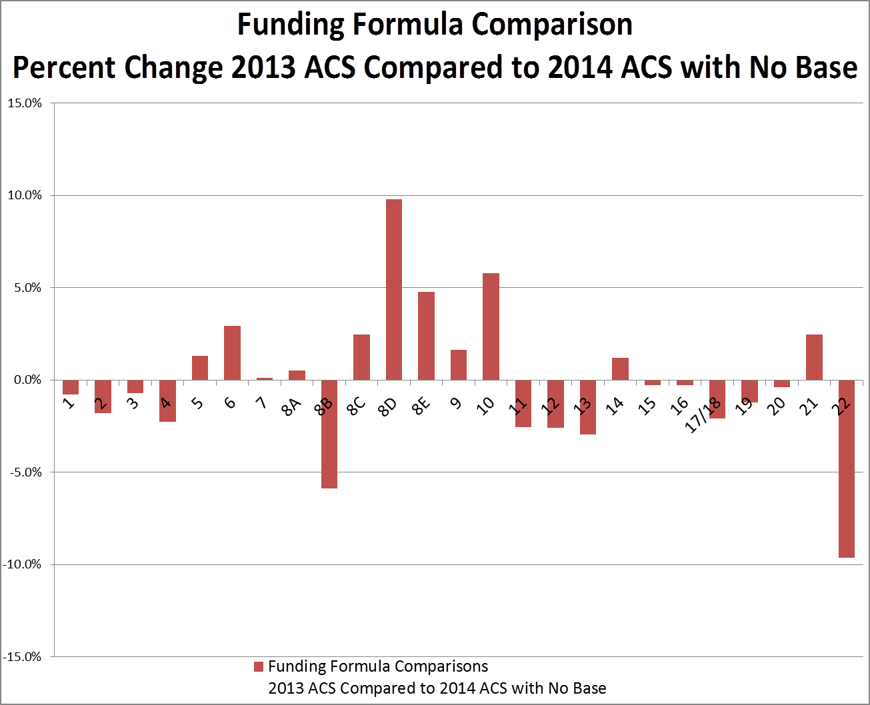
Funding Formula
Notes:
This is the Funding Formula comparison showing the Percent change using most recent ACS data to previous ACS data with No Base.

Slide 26
Funding Formula
Notes:
This comparison shows the Funding Formula change using the most recent ACS data to the previous ACS.

Slide 27
Funding Allocation Process
DARS determines funds available for allocation to AAAs as follows:
Prior to allocation of funds DARS makes the following transfers:
15% of Title III-C(1) to Title III-C(2)
20% of the total of Title III-C to Title III-B from Title III-C(1)
The administrative funds are calculated using the Notice of Grant Award for the current FFY. This fee is calculated as 5% of all Title III funds awarded.
In addition, a reserve amount is withheld to ensure that funds are not over obligated to AAAs.
The newly calculated funding formula is applied to the allocation amounts above a base of 50% of the Federal Fiscal Years 2012 allocation.
Finally there is a Hold Harmless adjustment to ensure no AAA receives less funding than was awarded in Federal Fiscal Year 2006.
State funding amounts are derived from the State Appropriation Act and used in calculating the allocations. They follow the same process listed above, with the exception of Ombudsman and Care Coordination for Elderly Virginians Program (CCEVP).
Our goal is to complete and distribute allocations by early June of each year.

Slide 28
Funding Allocation Process
Notes:
This is our Funding Allocation worksheet. The lower circled area contains the net (after reduction for admin funds and reserve) funds to be allocated. The base is subtracted from this allocation amount and the difference is processed through the allocation worksheet using the updated funding formulas circled in column two.
Each green highlighted (upper and lower) column contain the base funding amounts.
The amounts without highlights contain the calculated funds to be allocated above the base amounts.

Slide 29
Funding Allocation Process
Notes:
This is also part of our funding allocation worksheet. The circled area illustrates how the hold harmless is applied. The total funds allocated are compared to the Fiscal Year 2006 Hold Harmless Level. If any AAA has an amount less than the level in 2006, then a Hold Harmless amount will be applied for that AAA.

Slide 30
Funding Allocation Process
Notes:
This is the Worksheet for Title III-D allocations. The same funding formula is applied using a base of $2000.00 for each PSA.

Slide 31
OMBUDSMAN
The Ombudsman calculation is based on the total number of beds per PSA. A single AAA program has a base of $15,000, two or more AAAs that operate a joint program have a base of $25,000. The remainder is distributed in proportion to the number of licensed nursing facility beds, licensed assisted living facility beds, and licensed geriatric mental health beds located in each PSA.
Data sources used for these calculations are:
Nursing Home Beds: Virginia Department of Health, Office of Licensure and Certification “Directory of Long Term Care Services”, updated 08/2017 - www.vdh.virginia.gov/OLC/Facilities
Assisted Living Facility Beds: Va. Dept. of Social Services, Licensing Division, “Electronic List of Licensed Assisted Living and Adult Day Care Facilities”, as of 3/6/18
Mental Health Geriatric Care Beds: E-mail transmission from the Department of Behavioral Health & Developmental Services (DBHDS) dated 3/6/18.

Slide 32
Funding Allocation Process
Notes:
This is the worksheet for calculating the factor used in allocating Ombudsman funds. Nursing Facility Beds, Assisted Living Facility Beds and State Mental Health Facility Beds are added together to determine the Percent of State for each PSA. This percentage is the factor that is used in allocating Ombudsman funds.

Slide 33
Funding Allocation Process
Notes:
The factor is then used on the amount above the base to allocate the Ombudsman funds.

Slide 34
Funding Allocation Process
Notes:
Same Ombudsman factor is used to allocate the DMAS Ombudsman funding as well.

Slide 35
Funding Allocation
Agencies can carryover an amount equal to 10% of the federal funding allocation for the next fiscal year.
Carryover is computed separately for each title.
Maximum carryover levels are provided as part of the funding allocation documents.
General funds cannot be carried over from one state fiscal year to the next.
All state funds must be obligated by June 30th of the fiscal year in which they are awarded and liquidated by September 30th of that year.

Slide 36
Other Funding Distribution Procedures Used by DARS
Care Coordination for Elderly Virginians Program: As requested by V4A, all providers of CCEVP service prior to the current fiscal year were held harmless at the levels existing when the program expansion was approved. New funds were divided to bring low-funded programs to the minimum of $57,823.
Nutrition Services Incentive Program (NSIP} funds are distributed based on each agency's portion of the total number of meals served in the last complete cycle.

Slide 37
Funding Allocation Process
Notes:
This is the worksheet used for allocating funds for Care Coordination for Elderly Virginians Program (CCEVP). All providers of this service are held harmless at a minimum of $57,823.

Slide 38
Funding Allocation Process
Notes:
This is the allocation worksheet for Nutrition Services Incentive Program (NSIP) which is based on total meals served in the previous year.

Slide 39
Other Funding Distribution Procedures Used by DARS
Funding for the Farmers Market Fresh for Seniors program, Respite Care Initiative, Public Guardianship, Chronic Disease Self-Management, A Matter of Balance, Supplemental Nutrition Assistance Program, and other specialized programs is based on awards for proposals submitted by applicant agencies. Historical data is often a factor. Not all Agencies on Aging provide these services.
Title V Senior Community Service Employment program funds are distributed to selected areas in coordination with "national sponsors." "Equitable distribution," based on Census and employment data, is considered.

Slide 40
Area Plan Timeline
Timeline
May
Area plan & budget to AAA's
July
Area Plan & budget returned by AAAs
August
Review & revisions
September
Final review, approval, and obligations
October
Contracts finalized
Notes:
The Area Plan Timeline begins in May with the Area Plan & budget being made available to AAA’s so that they can be submitted to DARS by the end of July. These documents are reviewed in August and revisions are requested if needed. In September, a final review is done to approve and Obligations are sent with the contract to AAA’s so that they can be finalized by October.

Slide 41
Obligations
Obligations between DARS-OAS and an AAA occur once the contracts have been executed. The obligation sheets contain the funding sources by fiscal year(s).
Notes:
Line 1 inside the upper circle represents unexpended funds per the remittance sheet.
Line 2 inside the upper circle represents unallocated (reserve) funds for the previous fiscal year.
The lower circle contains the new FFY funding.

Slide 42
Contracts
By Contract AAAs are required to follow:
Freedom of Information Act;
Public Procurement Act;
The State & Local Government Conflict of Interest Act;
All subcontractors are required to adhere to DARS Service Standards; and
AAAs shall annually monitor the activities of their subcontractors.
Update all documents timely as changes occur (key personnel changes – board and council members, contractor information form)
Modifications – Any changes to contracts relating to financial or service matters.

Slide 43
Questions
???

